Slide 1

We interrupt this broadcast to bring you an important message… Please standby

Slide 2
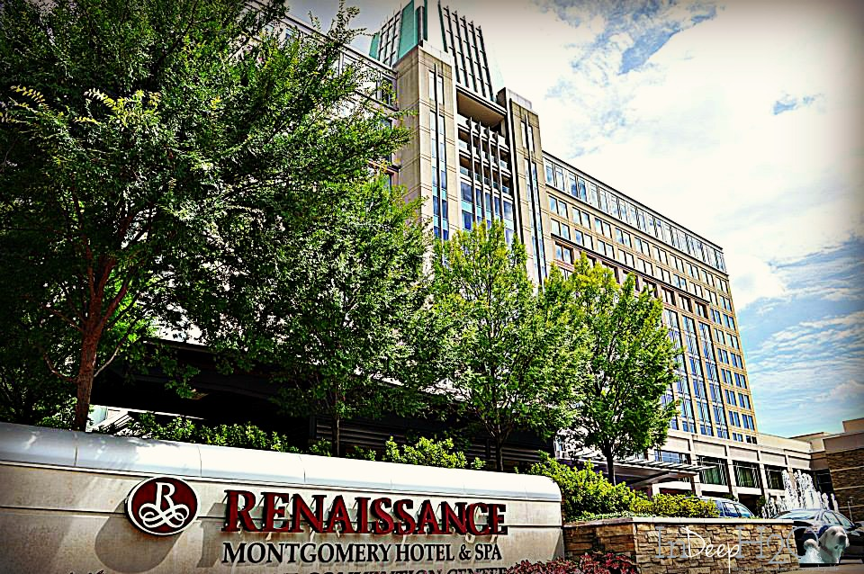
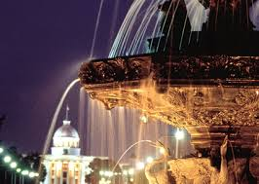
Today’s Top Story
INLINE Broadcasting Considers the Renaissance Montgomery Hotel & Spa for their Annual Sales Conference Winter 2019
But first, let’s check in with Sports…

Slide 3
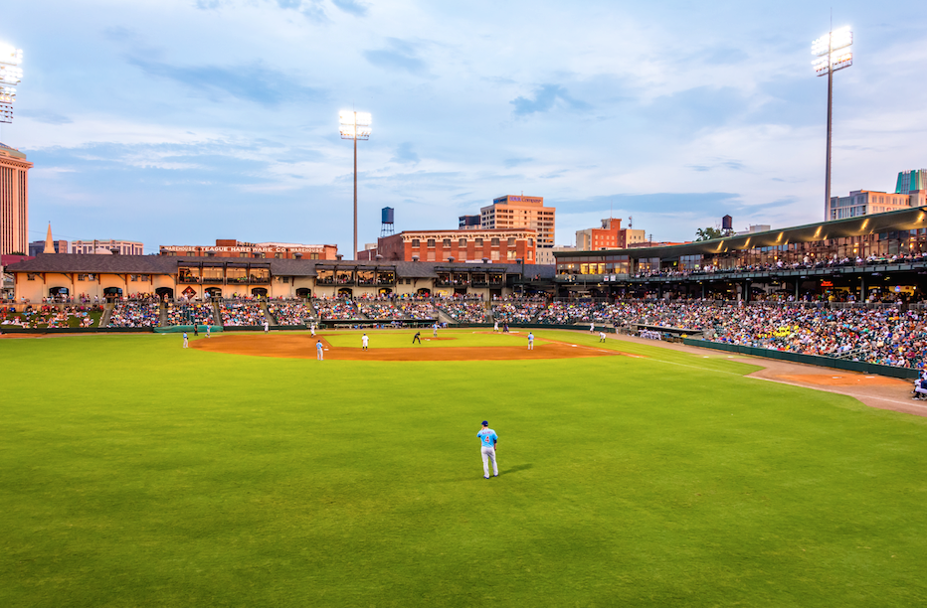
Renaissance Montgomery Hotel & Spa vies for a spot in the playoffs
The other teams aren’t making it easy, but here’s a few reasons why Montgomery can clinch the Southeast for 2019:
A hidden gem located in the heart of the entertainment district
Southern hospitality at its finest
MVP level treatment for everyone on the team
One Cracker Jack of a deal for INLINE Broadcasting

Slide 4
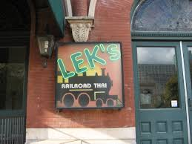
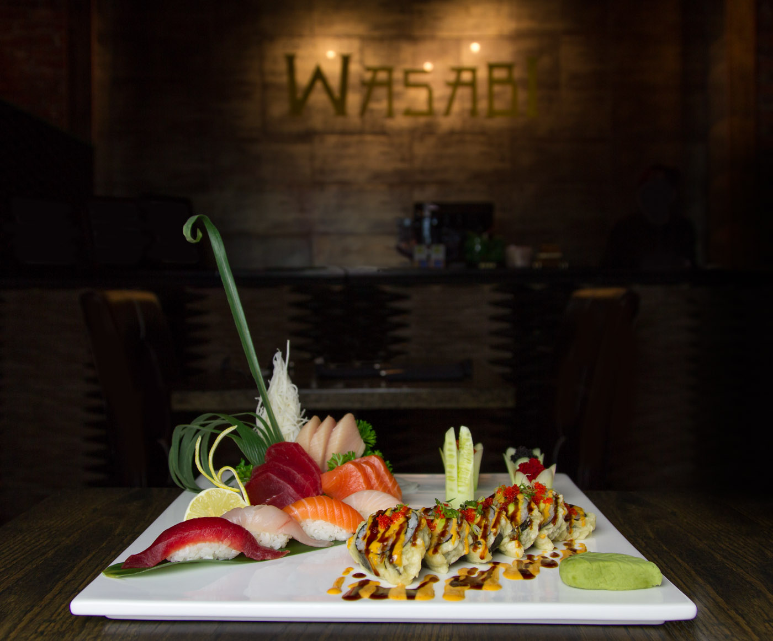
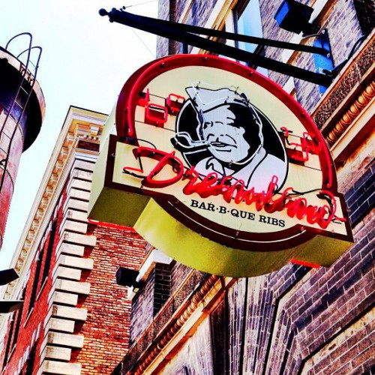
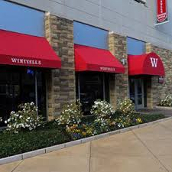
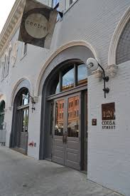
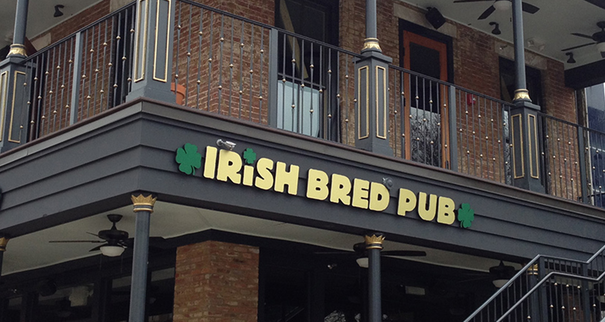
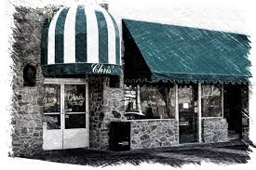
Brought to you by…

Slide 5

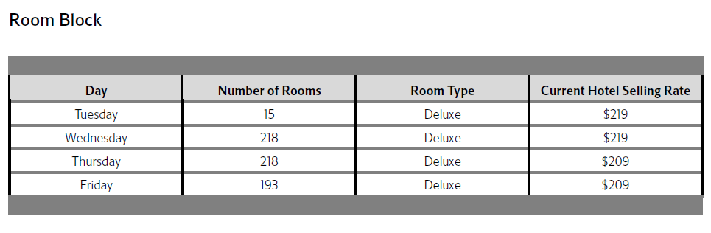
February 5-9, 2019: $167 (a total savings of over $30,200) February 12-16, 2019: $159 (a total savings of over $35,400)

Slide 6
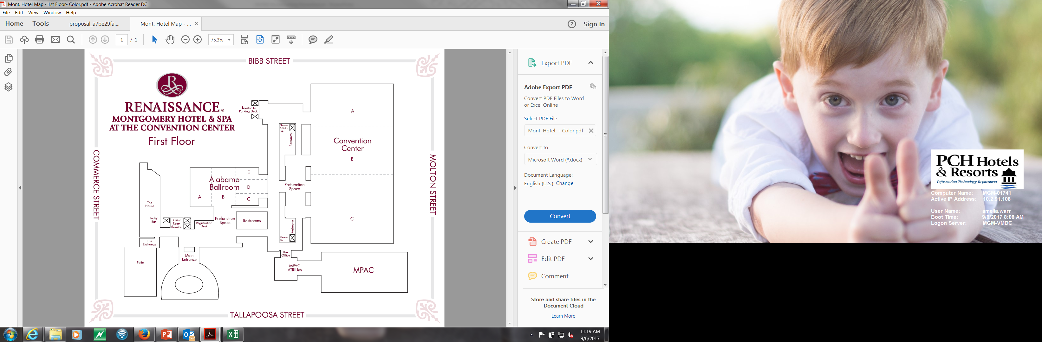

Slide 7
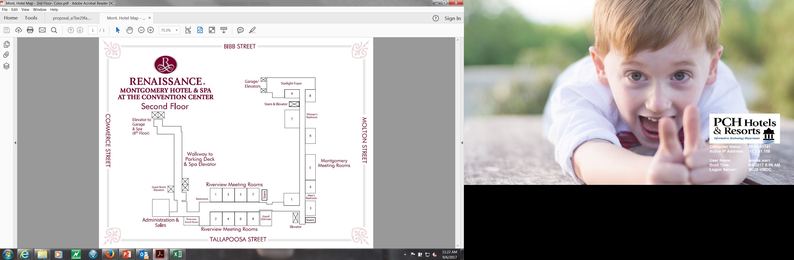

Slide 8

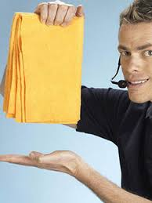

But wait, there’s more!
Group Discounted Rate (savings up to $41,800)
One complimentary upgrade to a Governors Suite at the Group Rate (total value of over $4,000)
Up to two complimentary upgrades to Executive Suites at the Group Rate (total value of over $1,900)
Complimentary Meeting Room Rental with a $48,300 Food and Beverage Minimum met (total value of over $29,500)
Overnight self-parking included in the Group Rate (total value of over $7,700)
One per fifty complimentary room nights (total value of up to $1,900)

Slide 9

“Most Valuable Pattern” Dates
Sunday, February 17- Thursday, February 21, 2019:
$139 (a total savings of over $41,800)
Additional Concessions Offered if these dates are selected:
One complimentary wireless internet connection in the meeting space (total value of over $100)
10% discount on Audio Visual services provided by Encore Event Technology (total estimated value of over $2,500)
One per thirty-five complimentary room nights (based on actualized room nights at or above the group rate) (total value of up to $3,000)

Slide 10

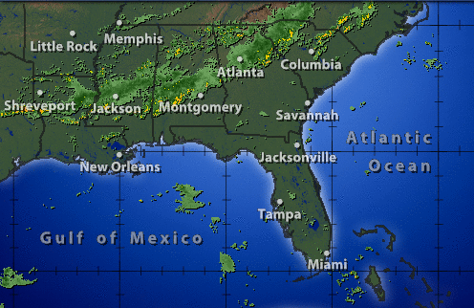
100% Chance of Savings in Montgomery
Total estimated savings:
$90,500!

Slide 11

Coming up on Day 1… “A Dinner to Remember” ( ) If you can imagine it, our Executive Chef Dean Donnell can create it. More concerned about the greens in your wallet than on your plate? Chef Dean is also able to create a custom menu to fit within your event budget.

Slide 12
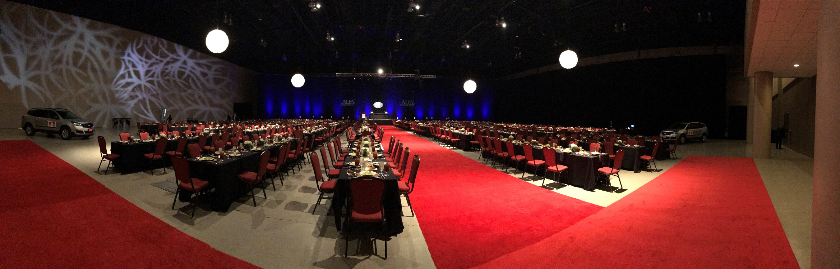
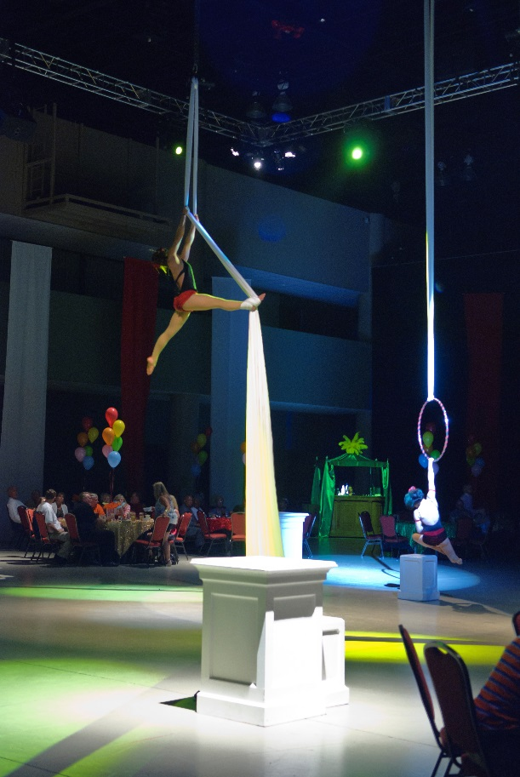
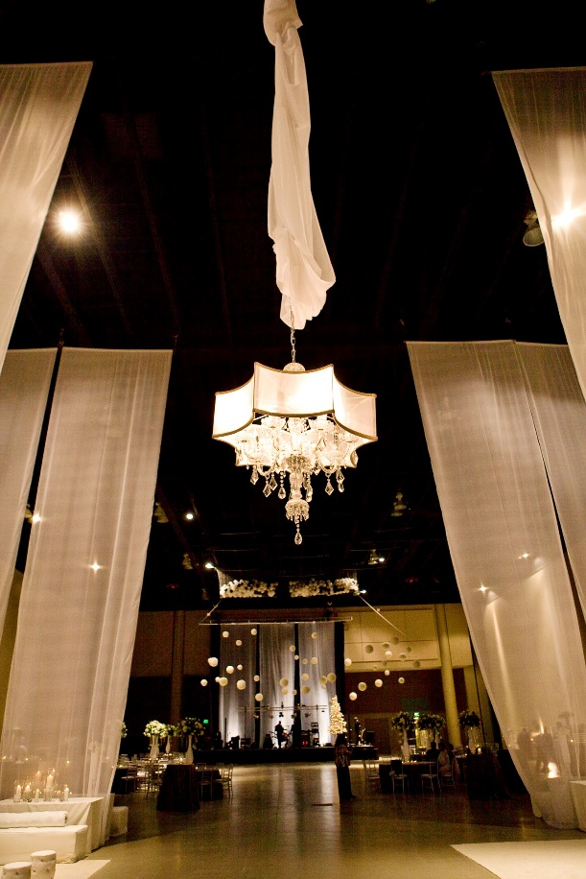
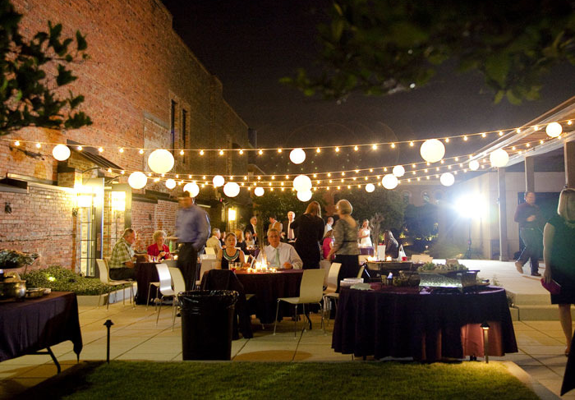
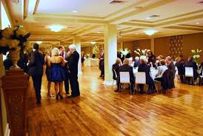
Want dinner to go? We cater to off site locations too!

Slide 13
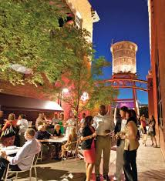
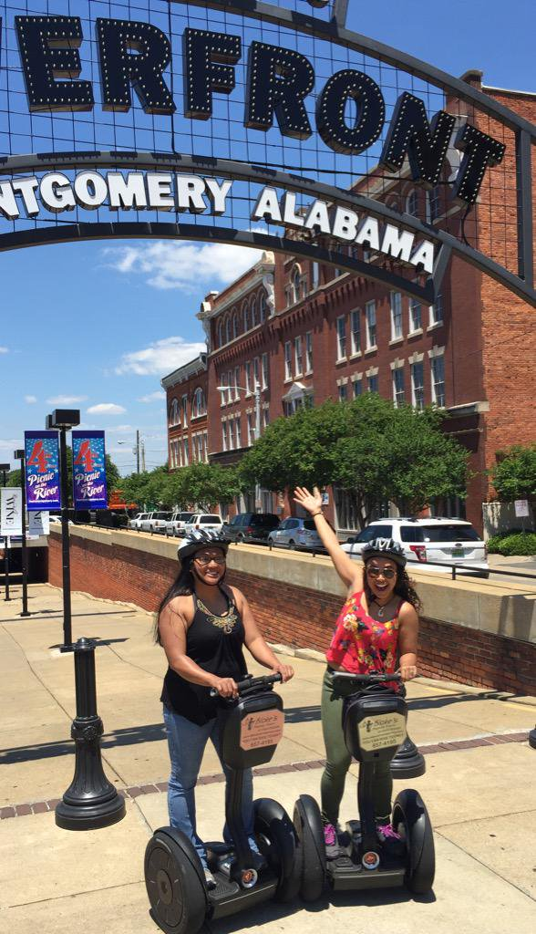
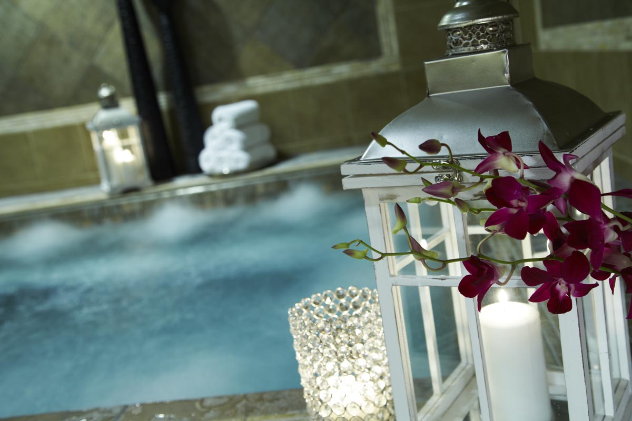
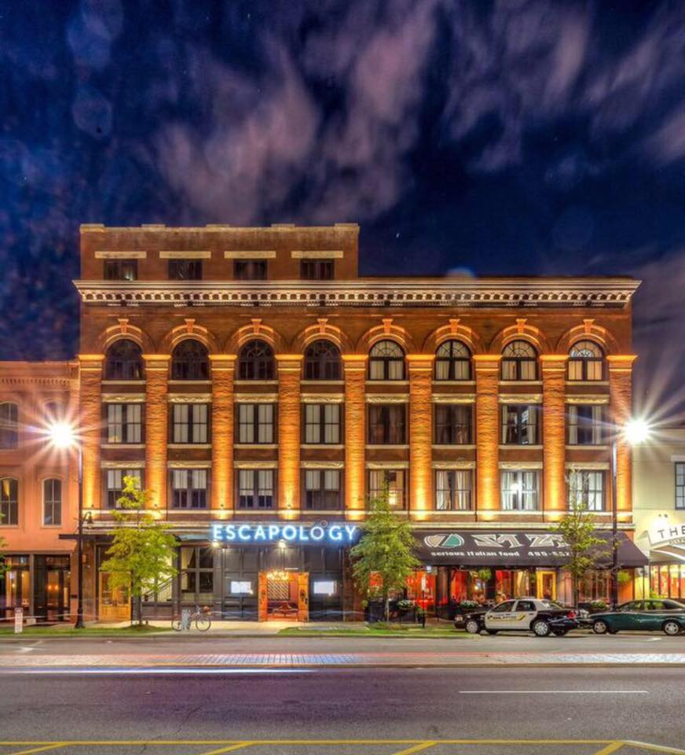
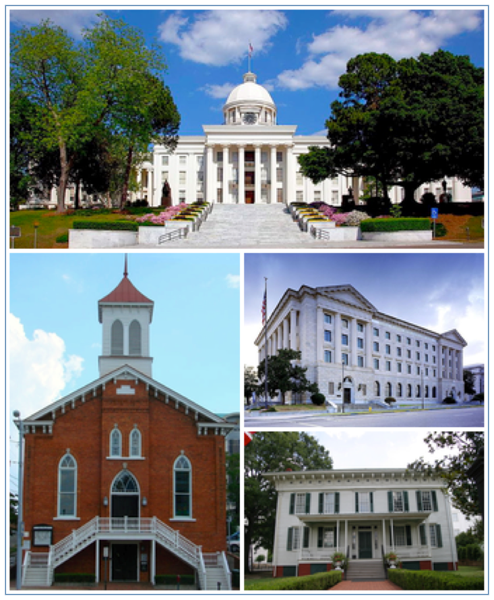
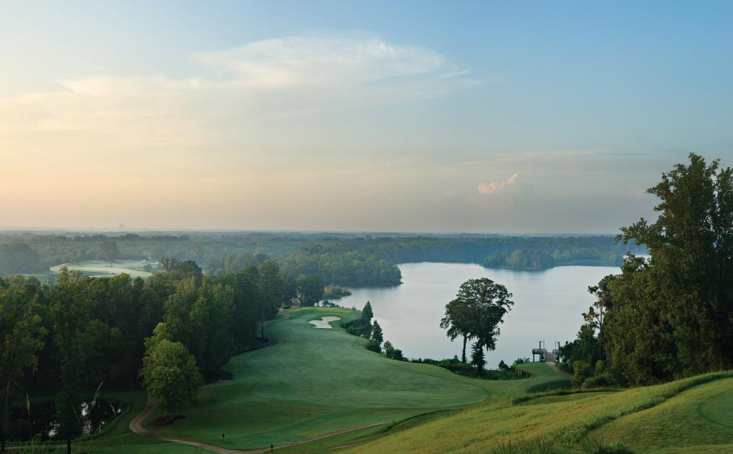

Today’s Top Entertainment News

Slide 14
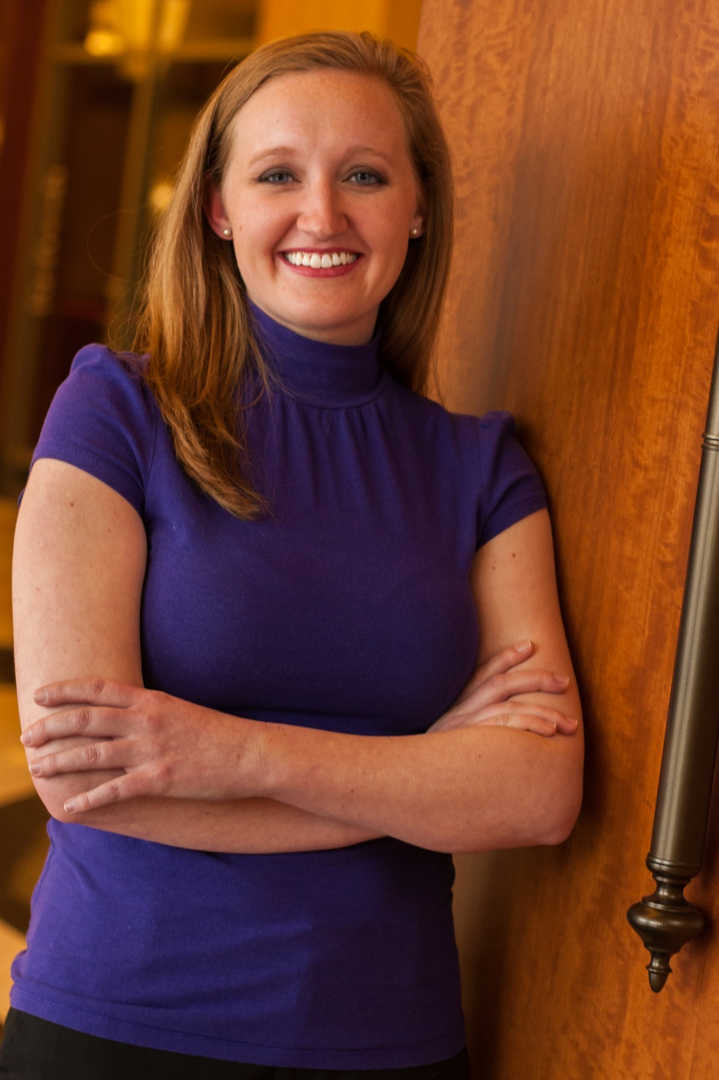
For the Renaissance Montgomery Hotel & Spa, I’m Amelia Warr. Thank you for your consideration and goodnight.

